Slide 1
Chapter 5
More SQL: Complex Queries, Triggers, Views, and Schema Modification

Slide 2
Chapter 5 Outline
More Complex SQL Retrieval Queries
Specifying Constraints as Assertions and Actions as Triggers
Views (Virtual Tables) in SQL
Schema Change Statements in SQL

Slide 3
More Complex SQL Retrieval Queries
Additional features allow users to specify more complex retrievals from database:
Nested queries, joined tables, outer joins, aggregate functions, and grouping

Slide 4
Comparisons Involving NULL and Three-Valued Logic
Meanings of NULL
Unknown value
Unavailable or withheld value
Not applicable attribute
Each individual NULL value considered to be different from every other NULL value
SQL uses a three-valued logic:
TRUE, FALSE, and UNKNOWN

Slide 5
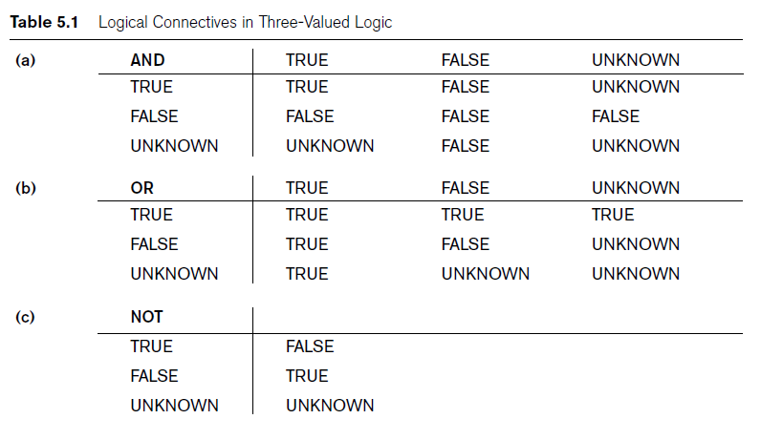
Comparisons Involving NULL and Three-Valued Logic (cont’d.)

Slide 6

Comparisons Involving NULL and Three-Valued Logic (cont’d.)
SQL allows queries that check whether an attribute value is NULL
IS or IS NOT NULL

Slide 7
Nested Queries, Tuples, and Set/Multiset Comparisons
Nested queries
Complete select-from-where blocks within WHERE clause of another query
Outer query
Comparison operator IN
Compares value v with a set (or multiset) of values V
Evaluates to TRUE if v is one of the elements in V

Slide 8
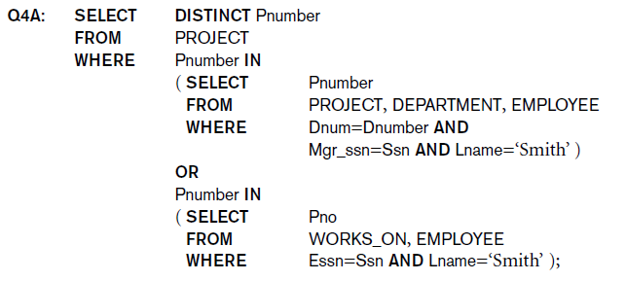
Nested Queries (cont’d.)

Slide 9
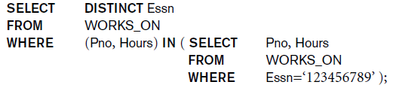
Nested Queries (cont’d.)
Use tuples of values in comparisons
Place them within parentheses

Slide 10
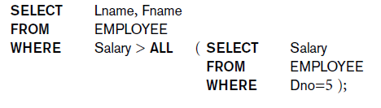
Nested Queries (cont’d.)
Use other comparison operators to compare a single value v
= ANY (or = SOME) operator
Returns TRUE if the value v is equal to some value in the set V and is hence equivalent to IN
Other operators that can be combined with ANY (or SOME): >, >=, <, <=, and <>

Slide 11
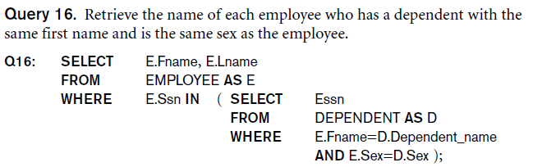
Nested Queries (cont’d.)
Avoid potential errors and ambiguities
Create tuple variables (aliases) for all tables referenced in SQL query

Slide 12
Correlated Nested Queries
Correlated nested query
Evaluated once for each tuple in the outer query

Slide 13
The EXISTS and UNIQUE Functions in SQL
EXISTS function
Check whether the result of a correlated nested query is empty or not
EXISTS and NOT EXISTS
Typically used in conjunction with a correlated nested query
SQL function UNIQUE(Q)
Returns TRUE if there are no duplicate tuples in the result of query Q

Slide 14
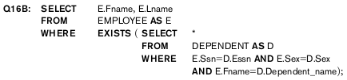
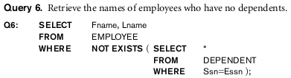
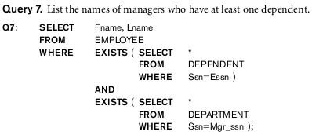
The EXISTS and UNIQUE Functions in SQL

Slide 15


Explicit Sets and Renaming of Attributes in SQL
Can use explicit set of values in WHERE clause (Example)
Use qualifier AS followed by desired new name
Rename any attribute that appears in the result of a query

Slide 16


Joined Tables in SQL and Outer Joins
Joined table
Permits users to specify a table resulting from a join operation in the FROM clause of a query
The FROM clause in Q1A
Contains a single joined table

Slide 17

Joined Tables in SQL and Outer Joins (cont’d.)
Specify different types of join
NATURAL JOIN
Various types of OUTER JOIN
NATURAL JOIN on two relations R and S
No join condition specified
Implicit EQUIJOIN condition for each pair of attributes with same name from R and S

Slide 18

Joined Tables in SQL and Outer Joins (cont’d.)
Inner join
Default type of join in a joined table
Tuple is included in the result only if a matching tuple exists in the other relation
LEFT OUTER JOIN
Every tuple in left table must appear in result
If no matching tuple
Padded with NULL values for attributes of right table

Slide 19

Joined Tables in SQL and Outer Joins (cont’d.)
RIGHT OUTER JOIN
Every tuple in right table must appear in result
If no matching tuple
Padded with NULL values for the attributes of left table
FULL OUTER JOIN
Can nest join specifications

Slide 20
Aggregate Functions in SQL
Used to summarize information from multiple tuples into a single-tuple summary
Grouping
Create subgroups of tuples before summarizing
Built-in aggregate functions
COUNT, SUM, MAX, MIN, and AVG
Functions can be used in the SELECT clause or in a HAVING clause

Slide 21
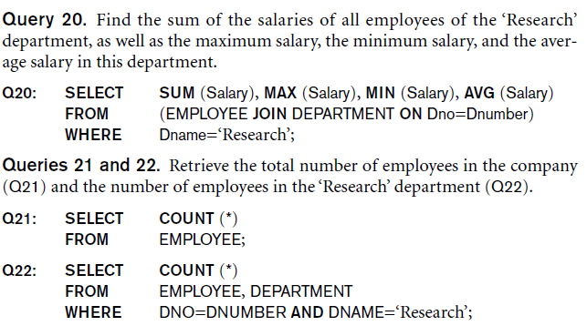

Aggregate Functions in SQL (cont’d.)
NULL values discarded when aggregate functions are applied to a particular column

Slide 22
Grouping: The GROUP BY and HAVING Clauses
Partition relation into subsets of tuples
Based on grouping attribute(s)
Apply function to each such group independently
GROUP BY clause
Specifies grouping attributes
If NULLs exist in grouping attribute
Separate group created for all tuples with a NULL value in grouping attribute

Slide 23

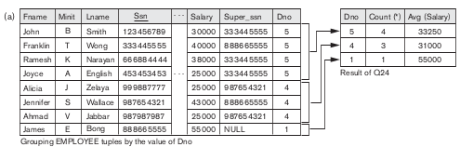
Grouping: The GROUP BY and HAVING Clauses

Slide 24
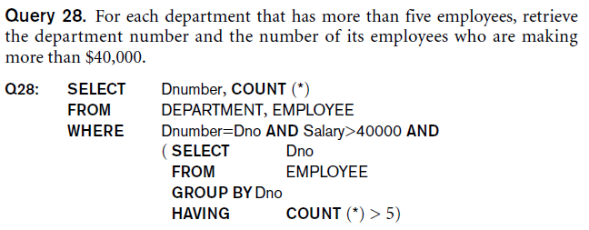
Grouping: The GROUP BY and HAVING Clauses (cont’d.)
HAVING clause
Provides a condition on the summary information

Slide 25
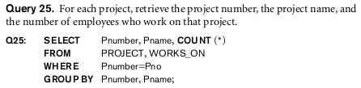
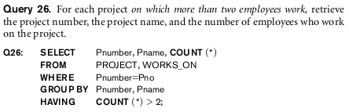
Grouping: The GROUP BY and HAVING Clauses (cont’d.)

Slide 26
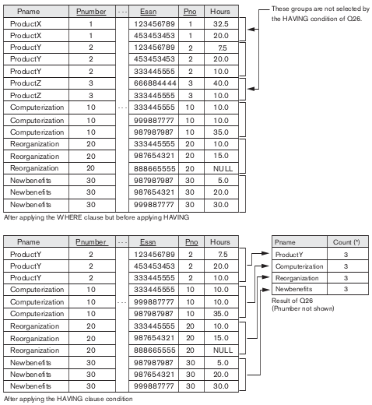

Slide 27
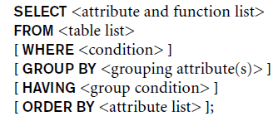
Discussion and Summary of SQL Queries

Slide 28
Specifying Constraints as Assertions and Actions as Triggers
CREATE ASSERTION
Specify additional types of constraints outside scope of built-in relational model constraints
Some constraints cannot be expressed by using only domain constraints or referential-integrity constraints; for example,
“Every department must have at least five courses offered every semester” – must be expressed as an assertion
CREATE TRIGGER
Specify automatic actions that database system will perform when certain events and conditions occur

Slide 29
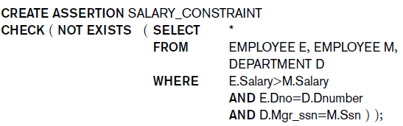
Specifying General Constraints as Assertions in SQL
CREATE ASSERTION
Specify a query that selects any tuples that violate the desired condition
Use only in cases where it is not possible to use CHECK on attributes and domains

Slide 30
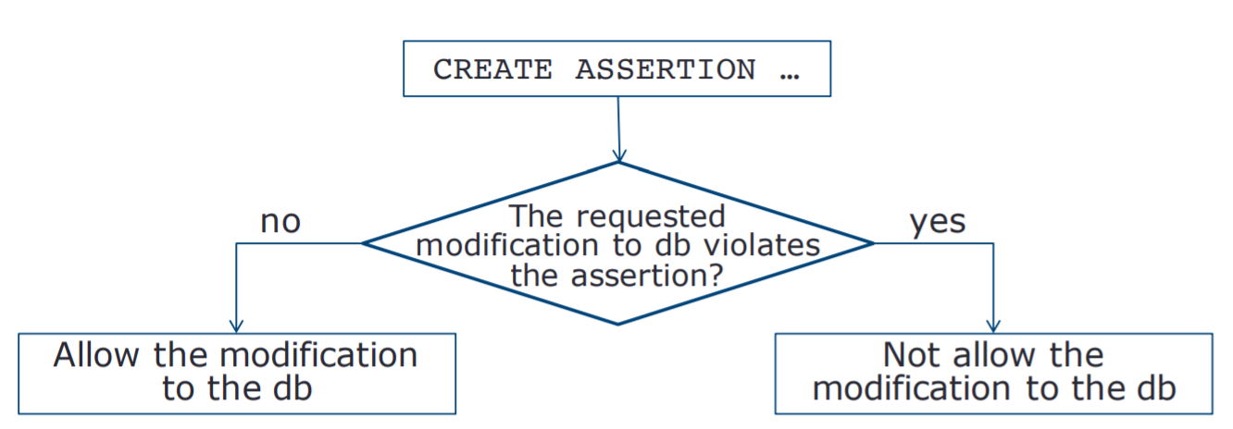
Specifying General Constraints as Assertions in SQL

Slide 31


Introduction to Triggers in SQL
CREATE TRIGGER statement
Used to monitor the database
Typical trigger has three components:
Event(s)
Condition
Action

Slide 32
Views (Virtual Tables) in SQL
Concept of a view in SQL
Single table derived from other tables
Considered to be a virtual table

Slide 33
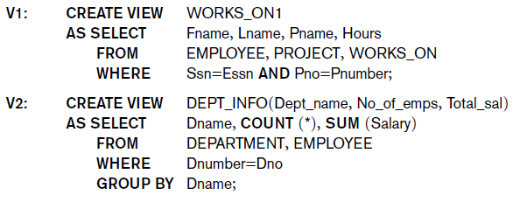
Specification of Views in SQL
CREATE VIEW command
Give table name, list of attribute names, and a query to specify the contents of the view

Slide 34

Specification of Views in SQL (cont’d.)
Specify SQL queries on a view
View always up-to-date
Responsibility of the DBMS and not the user
DROP VIEW command
Dispose of a view

Slide 35
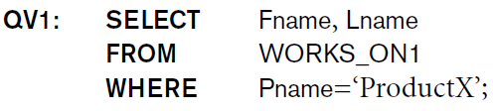

View Implementation, View Update, and Inline Views
Complex problem of efficiently implementing a view for querying
Query modification approach
Modify view query into a query on underlying base tables
Disadvantage: inefficient for views defined via complex queries that are time-consuming to execute

Slide 36
View Implementation
View materialization approach
Physically create a temporary view table when the view is first queried
Keep that table on the assumption that other queries on the view will follow
Requires efficient strategy for automatically updating the view table when the base tables are updated

Slide 37
View Implementation (cont’d.)
Incremental update strategies
DBMS determines what new tuples must be inserted, deleted, or modified in a materialized view table

Slide 38
View Update and Inline Views
Update on a view defined on a single table without any aggregate functions.
Can be mapped to an update on underlying base table.
A view with a single defining table is updatable if the view attributes contain the primary key of the base relation, as well as all attributes with the NOT NULL constraint that do not have default values specified.
Views defined on multiple tables using joins are generally not updatable.
Views defined using grouping and aggregate functions are not updatable.

Slide 39
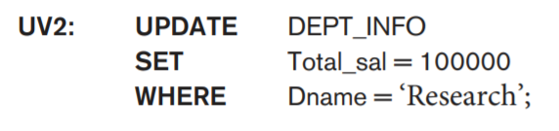
View Update and Inline Views
A user can always issue a retrieval query against any view. However, issuing an INSERT, DELETE, or UPDATE command on a view table is in many cases not possible.

Slide 40
Schema Change Statements in SQL
Schema evolution commands
Can be done while the database is operational
Does not require recompilation of the database schema

Slide 41
The DROP Command
DROP command
Used to drop named schema elements, such as tables, domains, or constraint
Drop behavior options:
CASCADE and RESTRICT
Example:
DROP SCHEMA COMPANY CASCADE;

Slide 42
The ALTER Command
Alter table actions include:
Adding or dropping a column (attribute)
Changing a column definition
Adding or dropping table constraints
Example:
ALTER TABLE COMPANY.EMPLOYEE ADD COLUMN Job VARCHAR(12);
To drop a column
Choose either CASCADE or RESTRICT

Slide 43


The ALTER Command (cont’d.)
Alter a column definition
by dropping an existing default clause
by defining a new default clause.
Change constraints specified on a table
Add or drop a named constraint

Slide 44
Summary
Complex SQL:
Nested queries, joined tables, outer joins, aggregate functions, grouping
CREATE ASSERTION and CREATE TRIGGER
Views
Virtual or derived tables

